Slide 1

Banking Transaction Fraud Detection
CIDM 6395 : Capstone Project John Anokye

Slide 2
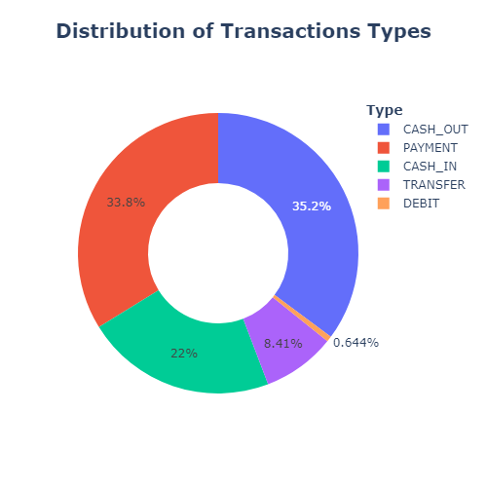
Problem Statement
Online transaction has rapidly expanded and become the norm of bank transaction.
Fraudulent banking transactions have become difficult to detect due to its dynamic nature of fraud
This project aims to correctly predict fraudulent bank transaction in near-real time
Conduct data analytics study to determine the best machine learning/deep learning model for prediction
Select best model and build a production ready application capable of identfying fradulent transactions in real time.
Challenges Found in Datasets
Many machine learning algorithms to choose from
Large datasets > 1,000,000 with less than 1 % of suspicious transactions
Imbalanced dataset
Limitation of High Power Computers (HPC) to handle large datasets

Slide 3

ML Model Development - Methodology
Data formatting
10 variables
Step, type, amount, nameOrigin, oldbalanceOrig, newbalanceOrig, nameDest, oldbalanceDest, newbalanceDest, isFraud, isFlaggedFraud
Y_train contains target variables - isFraud
X_train contains the remaining 6 variables
600,000 random samples from 6,000,000 data points
Three supervised machine learning algorithms were used to test the hypothesis and a deep learning algorithm was also used
Logistic Regression
KNN
Decision Tree
Neural Networks (Tensorflow)

Slide 4
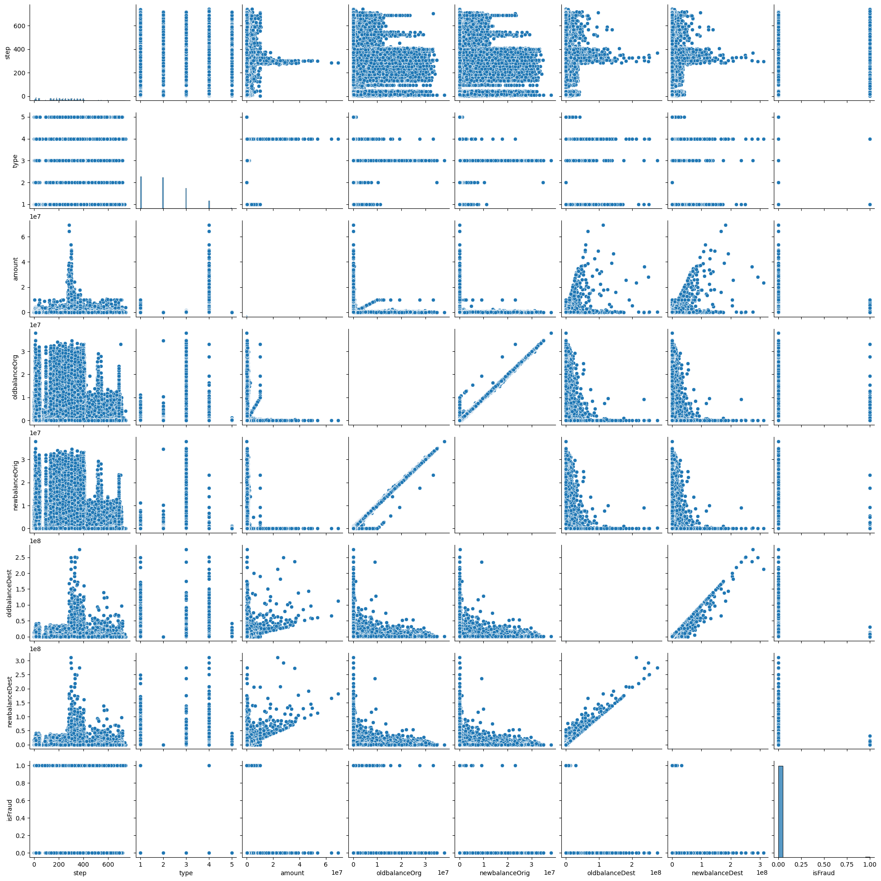
Data Analytics (EDA)- Pearson Correlation
A Pearson correlation matrix highlights pairs of features that move linearly in tandem.
Detect potential multicollinearity. Multicollinearity occurs when multiple predictors in a model are highly correlated. This can cause instability in models like Logistic Regression or Linear Regression, where coefficients become unreliable or inflate variance.
Overfitting issues with highly correlated features

Slide 5
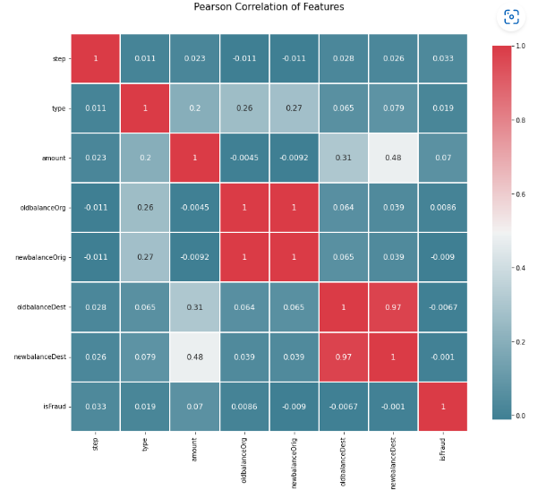
Data Exploration- Pearson Correlation

Slide 6
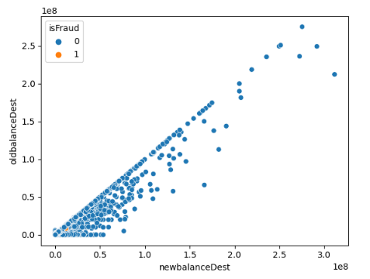
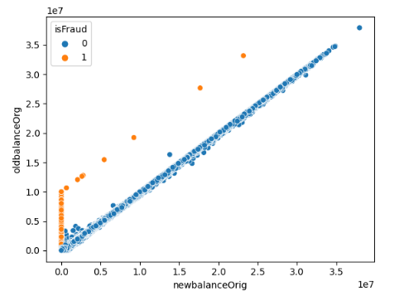
Assumptions and Plots
Assumption: Fraudulent and non fraudulent bank activities is linearly separable, little to outliers,the dependent/response variable is binary.
Looking at the 4 highly correlated features below:

Slide 7
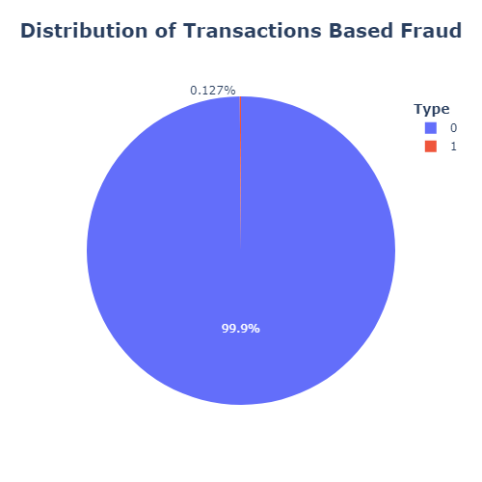
Data Processing (Data Management)
Preprocessing
No null values (NaN)
Training set 80% dataset
Test set 20%
Dropping of irrelevant columns to reduce the dimensionality of the model 'isFlaggedFraud', 'nameOrig', 'nameDest'
Highly imbalanced dataset
Challenge:
Accurately predict 0.127% fraudulent class
Converted payment type into categorical numerical features.
CASH_OUT : 1
PAYMENT :2
CASH_IN : 3
TRANSFER : 4
DEBIT :5

Slide 8
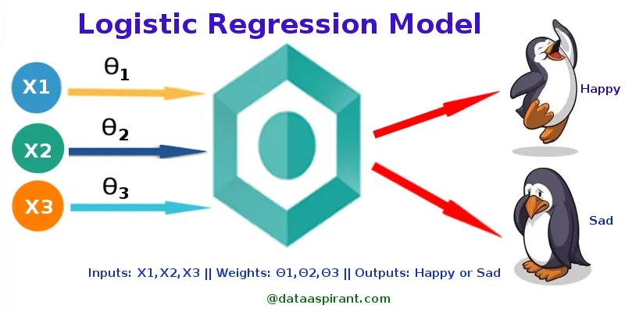
Methodology- Logistic Regression
Measures the relationship between the dependent and independent variable by estimating probability
Likelihood that an event will occur
Binary outcomes (yes/no or true/false)
Applications include:
Hotel Booking - booking.com
Gaming - In-game purchases
Figure 1: Logistic Regression Model (Source:http://dataaspirant.com/2017/03/02/how-logistic-regression-model-works/)

Slide 9
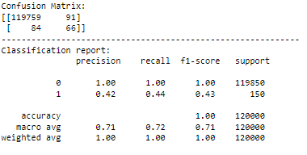
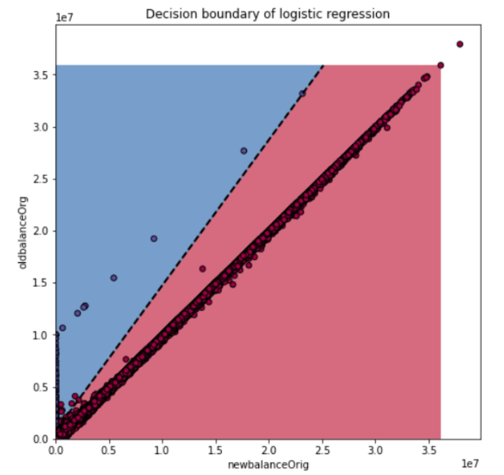
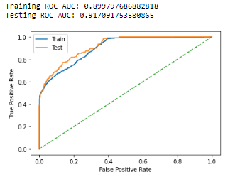
Results- Logistic Regression
Training Accuracy : 0.9984458333333334
Testing Accuracy: 0.9985416666666667

Slide 10
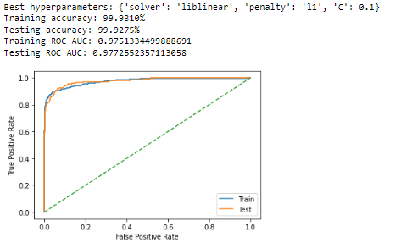
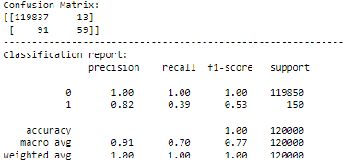
Model Selection- Logistic Regression
Hyperparameters C, solver and penalty were tuned to select the best logistic regression model using RandomSearch Cross Validation. 'C': [0.001, 0.01, 0.1, 1, 10, 100], 'solver': ['saga', 'liblinear'], 'penalty': ['l1', 'l2'] Lasso and Ridge regularization

Slide 11
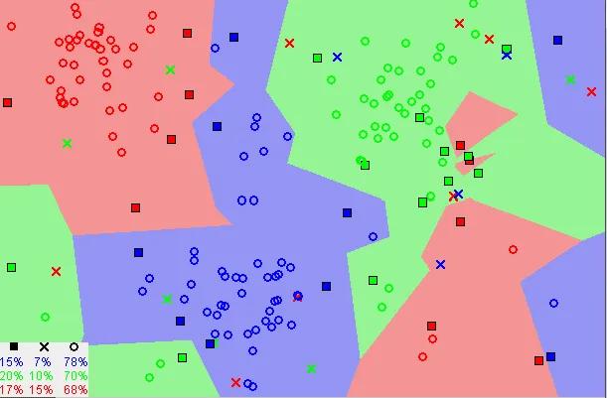
Methodology- K-Nearest Neighbor (KNN)
Relies on closest input data to classify it based on similarity
Common applications
Medicine to predict when a patience will be hospitalized due to heart attack based on demographic data
Finance to predict stock market forecasting based on market trends
Figure 2: K Nearest Neighbor Model (Source: https://towardsdatascience.com/machine-learning-basics-with-the-k-nearest-neighbors-algorithm-6a6e71d01761)

Slide 12
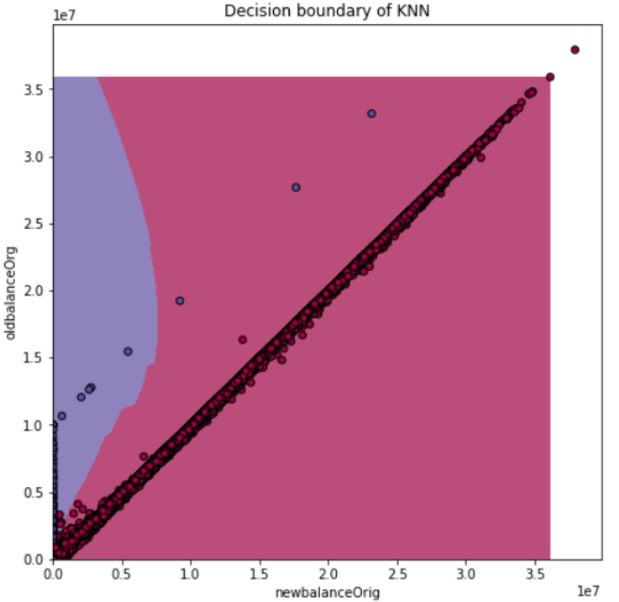
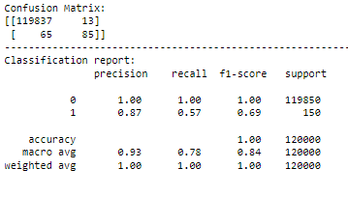
Results- K-Nearest Neighbor (KNN)
Training Accuracy :0.9994520833333334
Testing Accuracy: 0.99935

Slide 13
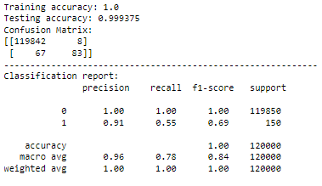
Model Selection- K-Nearest Neighbor (KNN)
Hyperparameters n_neighbors and weights were tuned to select the best KNN model using RandomSearch Cross Validation. 'n_neighbors': np.arange(1, 21), 'weights': ['uniform', 'distance']
Best hyperparameter =

Slide 14
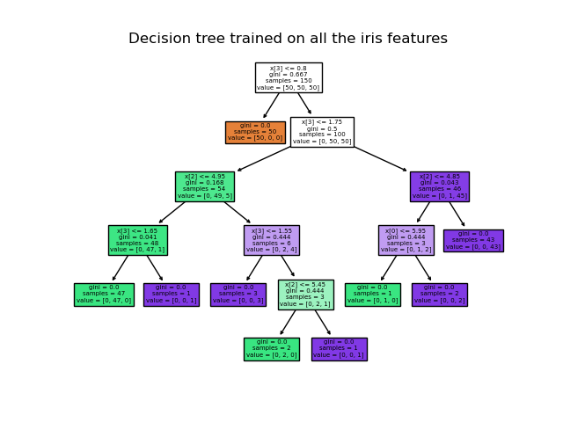
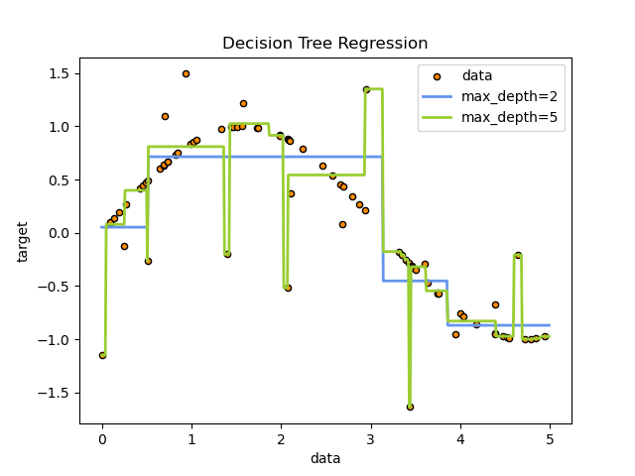
Methodology- Classification Tree
Classify and make decision
Branches represent attributes
Leaves represent decisions
Figure 4 & 5: CTM (Source: https://scikit-learn.org/stable/auto_examples/tree/plot_tree_regression.html)

Slide 15
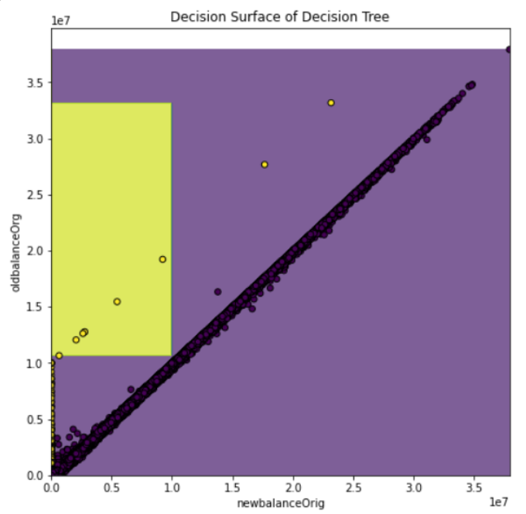
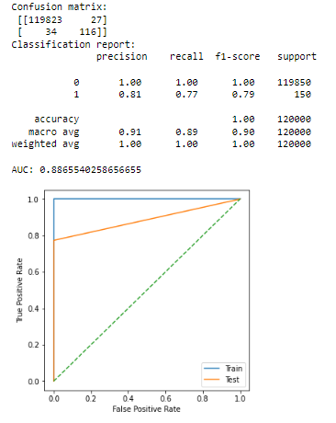
Results- Classification Tree
Training Accuracy : 1.0
Testing Accuracy: 0.9994916666666667

Slide 16
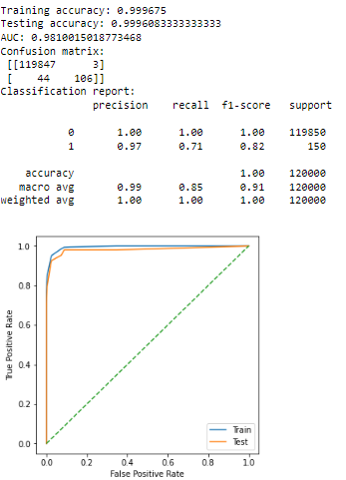
Model Selection - Classification Tree
Hyperparameters maximum depth, minimum samples split and minimum sample leaf were tuned to select the best decision tree model using RandomSearch Cross Validation.
'max_depth': [3, 5, 7, 10, None]
'min_samples_split': [2, 5, 10]
'min_samples_leaf': [1, 2, 4]
Best hyperparameters were :
min_samples_split = 5
min_samples_leaf = 2
max_depth = 5
98 %

Slide 17
Final Model Selection
Results in classification for the 4 models
Tree based classification performed best out of the 4
 | Logistic Regression | KNN | Decision Tree | Deep Learning (Tensorflow)
Recall | 0.44 | 0.55 | 0.71 | 0.50
Precision | 0.42 | 0.91 | 0.97 | 0.91
f1-score | 0.43 | 0.69 | 0.82 | 0.65

Slide 18
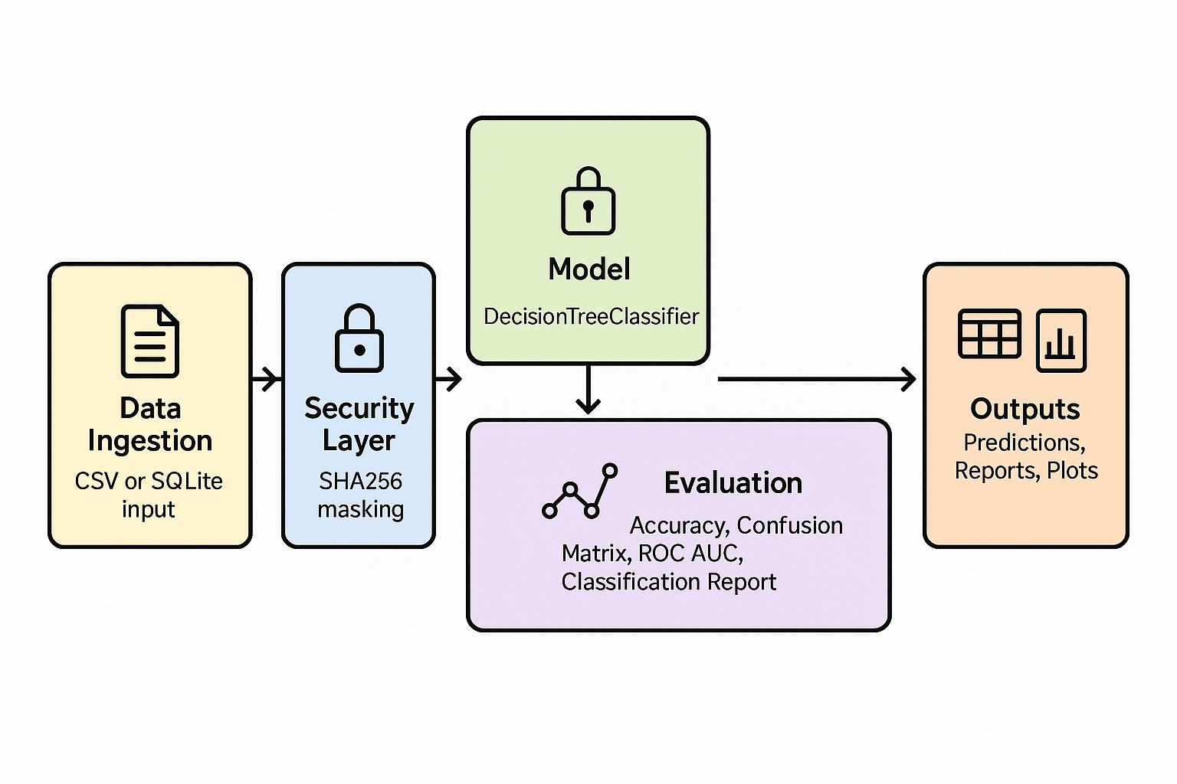
🛡️ Fraud Detection System
Secure, Scalable, and Auditable ML Pipeline for Transaction Fraud Detection

Slide 19
Fraud Detection System
A production-ready machine learning pipeline for fraud detection in bank transactions.
Detects fraudulent activity using Decision Tree classifier in a Scikit-learn pipeline.
Built with PII-safe preprocessing, automated evaluation, and modular testing.
Handles both labeled and unlabeled data sources (CSV or SQLite DB).
CSV files for training
SQLite/Database for deployment. Enhanced security due to authentication

Slide 20
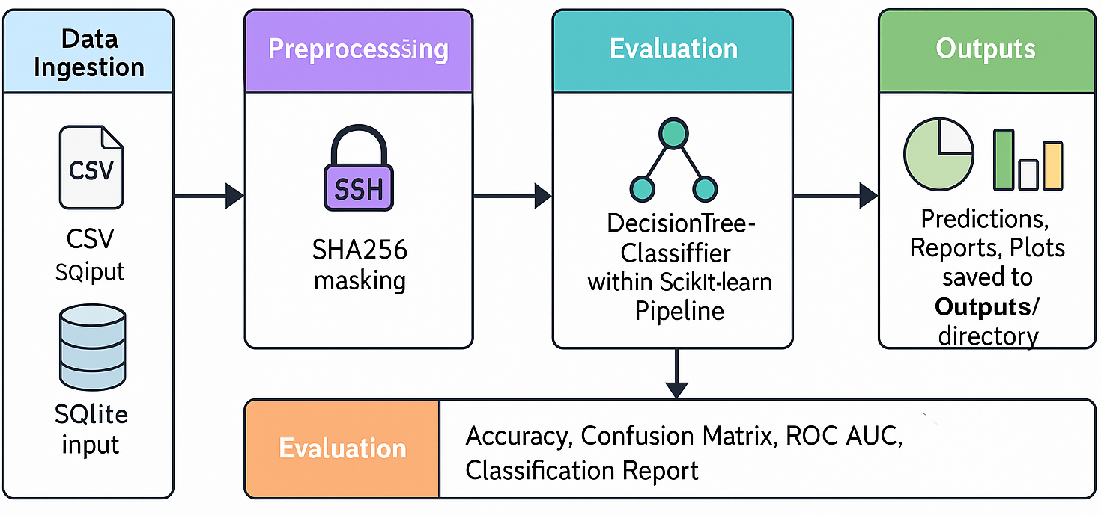
🏗️ Architecture & Components
Data Ingestion: CSV or SQLite input.
Security: SHA256 masking of sensitive fields (`nameOrig`, `nameDest`).
Model: DecisionTreeClassifier within Scikit-learn Pipeline.
Evaluation: Accuracy, Confusion Matrix, ROC AUC, Classification Report.
Outputs: Predictions, Reports, Plots saved to `Outputs/` directory

Slide 21
✨ Key Features
📊 Model Evaluation: Custom thresholding (0.3) for fraud probability.
🔐 PII Safety: Hashing of personally identifiable information.
💾 DB Integration: Read/write via SQLite for persistence and scale.
🧪 Unit Testing: Pytest suite covering preprocessing and DB loading.
📁 Organized output generation for seamless traceability and reproducibility.

Slide 22
⚙️ Usage & Extensibility
Code base is version-controlled using git (Git Repo)
Easily pluggable to cloud-based pipelines or dashboards.
Version-controlled, testable, and ready for deployment.
Future Ready: Extend with other ML models, monitoring tools, or web UI.
Demonstration

Slide 23
Conclusion and Recommendations
Machine Learning models can be used to predict fraudulent transactions as demonstrated.
Fraud is dynamic and metrics from the ML model should me monitored over time to explore its effectiveness
Future improvement on the machine learning is to explore other models such as Gradient Boosting (e.g., XGBoost or LightGBM)
Add stream input support (Kafka or S3)
Integrate with real-time dashboards using Streamlit or Dash
Implement a REST API for live scoring using FastAPI or Flask

